Slide 1



EVOLUTION FOR INDIVIDUALS ONLINE APPLICATION GUIDE
AN AID FOR FINANCIAL ADVISERS COMPLETING AN ONLINE APPLICATION FORM
This guide is intended for financial adviser use only.
It should not be distributed to, or relied upon, by retail clients.
UL PR 0270 | 11/22

Slide 2
A WEALTH OF EXPERTISE, EXPERIENCE,
UNDERSTANDING, SERVICE EXCELLENCE AND TECHNICAL SUPPORT THAT MAKES A DIFFERENCE FOR YOU AND YOUR CLIENTS
UL PR 0270 | 11/22

Slide 3

CONTENTS
Online Application Widget
4
Online Application Overview
6
Keying an Online Application
11
Sign and Submit
21
UL PR 0270 | 11/22

Slide 4
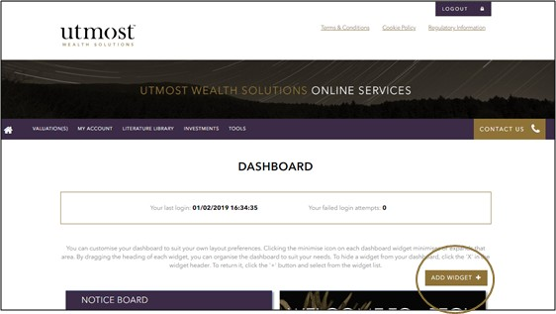
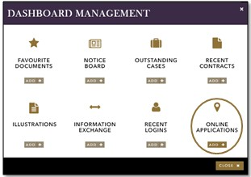

ONLINE APPLICATION WIDGET
ADDING THE WIDGET TO YOUR DASHBOARD
To begin, log on to www.utmostinternational.com , click ‘Online Service Login’, Select Utmost International Isle of Man Limited and click login. You should then be able to enter your Utmost International Isle of Man Limited credentials. On your 'dashboard', click 'add widget', as highlighted in the example.
The 'dashboard management' screen will now appear. In this screen, under 'online applications', click 'add'. The 'online applications' widget will now be added to your dashboard.
UL PR 0270 | 11/22

Slide 5
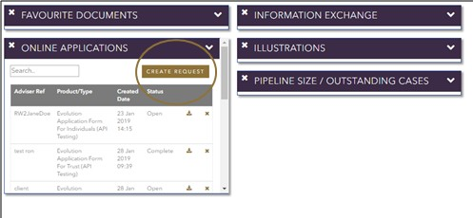
ONLINE APPLICATION WIDGET
WIDGET FEATURES
Now the 'online applications' widget has been added, this will appear on your dashboard, as shown in the example below.
The icon will open up any in progress applications for you to continue with the data entry and/or submit.
Whenever you start a new application or select an application that is already in progress, a new browser window will open. You can switch in between the online application screen and the Utmost website. This will enable you to refer to product guides, illustrations etc. should you wish to.
Applications that are already in progress will appear within the 'online applications' widget.
The widget also allows you to create a new application. You can do so by clicking 'create request', as shown.
UL PR 0270 | 11/22

Slide 6



OVERVIEW
THE BASICS TO START
Select an existing or start a brand new application
Input information, whilst being able to save, exit and return at any time
Upload mandatory supporting documents e.g. proof of identify and address verification
Sign using a touchscreen stylus for signatures or print, sign and scan onto your system and upload to the ‘notes’ tab
Submit the application securely to our Welcome team once complete.
UL PR 0270 | 11/22

Slide 7

OVERVIEW
NAVIGATING AROUND THE ONLINE APPLICATION FORM
Access each section of the online form using the tabs at the top of the page
Your data entries on each tab will automatically save when you navigate away and move onto the next section. You will need to click the save icon at the bottom of the page should you wish to exit the application.
You can find useful tips to guide you throughout the online form. Should you require further assistance, contact our Welcome team on +44 (0) 1624 653 251.
Do not use your browser 'back' button. This will close the application window.
UL PR 0270 | 11/22

Slide 8
OVERVIEW
ENTERING INFORMATION
MANDATORY
OPTIONAL
ADDITIONAL
The majority of sections within the online application are mandatory. These will be clearly indicated with a purple 'mandatory' box on the right hand side of the online form.
There are some sections which are 'optional', depending on the clients investment needs. Similarly to the mandatory sections, these will be clearly marked with a purple 'optional' box.
There are additional questions which are displayed depending on the data provided. These additional questions will automatially appear following the specific data input.
UL PR 0270 | 11/22

Slide 9
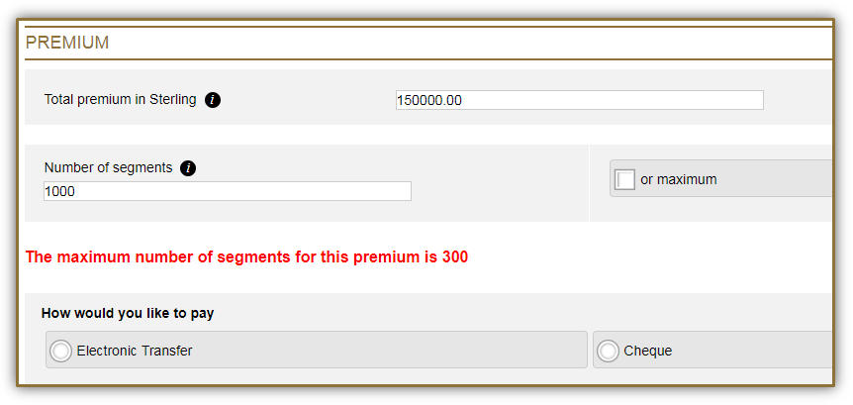
OVERVIEW
ENTERING INFORMATION
The data entered into the online form will be validated either immediately or when you navigate away from the current section.
In the below example, 1,000 segments has been manually entered, which is higher than the 300 permitted for a premium of £150,000. This can be corrected by manually entering the permitted maximum number of segments (300), or by ticking the 'or maximum' box.
A minimum of £500 (or currency equivalent) per segment is required.
UL PR 0270 | 11/22

Slide 10
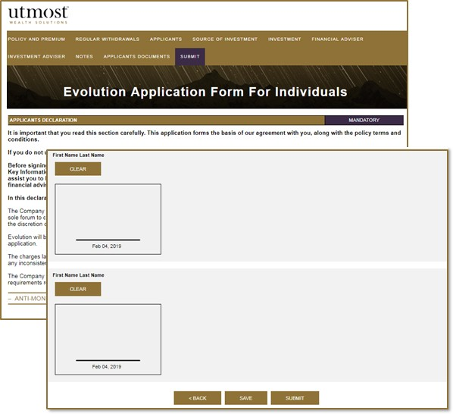
OVERVIEW
PRINTING A PDF VERSION OF THE ONLINE APPLICATION
Each individual party to the application is required to sign, and for those with access to a touchscreen device and a stylus, may allow their clients to sign electronically.
Alternatively, we will accept a PDF version of the form to be printed and signed. Once signed with a wet signature, it should then be uploaded online.
The data entry must be fully completed before printing. Any questions which have not been completed will not be included.
UL PR 0270 | 11/22

Slide 11


KEYING AN ONLINE APPLICATION
STARTING A NEW ONLINE APPLICATION
A unique reference number will be required from the outset. This should include the applicant's name for ease to you and Utmost staff. The information will be displayed on your dashboard.
The online applications are available for both new Evolution individual applicants and Evolution trustee applicants. This includes existing trusts, and applications for a new Trust or new Loan Trust, where the Utmost model trusts are used. Once the unique reference number has been entered, you will be asked to select either 'create new trust' or 'create new client'. If you are using our Trust Deed's the paper version must be completed and posted to our office separately.
UL PR 0270 | 11/22

Slide 12

KEYING AN ONLINE APPLICATION
POLICY & PREMIUM
Whilst you're able to complete the application in any order, we would recommend that the Policy and Premium tab would be a good place to start. As the data on this tab sets the basic parameters of the investment.
Basis of contract
The contract can be taken out on a Capital Redemption or Life Assured basis. If Life Assurance is selected, this will automatically pull through an additional tab for 'Additional Lives Assured'.
Currency of bond
Once the currency of the bond has been selected, this will automatically display the currency for other data fields i.e. withdrawal currency.
Total Premium
This information will be used to validate the maximum amount of segments available and also to allow for initial financial adviser charges to be considered.
Utmost's Product Management Charge
This is not to be confused with adviser charging. This is Utmost's bond charge.
UL PR 0270 | 11/22

Slide 13
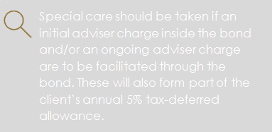
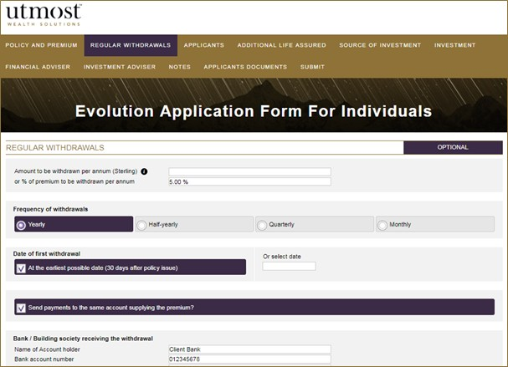
KEYING AN ONLINE APPLICATION
REGULAR WITHDRAWALS
The regular withdrawal section is optional. The client(s) is able to benefit from taking a regular income from the bond. The amount of annual withdrawals should be taken into consideration, as this will form part of the client's annual 5% tax-deferred allowance.
Special care should be taken if an initial adviser charge inside the bond and/or ongoing adviser charges are to be facilitated through the bond. These will also form part of the client’s annual 5% tax-deferred allowance.
UL PR 0270 | 11/22

Slide 14





KEYING AN ONLINE APPLICATION
APPLICANTS & ADDITIONAL LIVES ASSURED
Applicant 1 becomes the primary policyholder on the bond. If there is more than one applicant, the order in which they are input should be considered. The primary policyholder address will be used for all correspondence, unless stated otherwise.
A maximum of 6 lives assured is permitted.
For example, if applicant 1 is appointed as a life assured, there can only be an additional 5 lives assured. There is no minimum or maximum age limit on the appointed lives assured and the bond will end on the death of the last life assured.
Applicant details are mandatory and must be fully completed.
Additional Lives Assured section will only appear if the contract is on a Life Assurance basis.
14
UL PR 0270 | 11/22

Slide 15

KEYING AN ONLINE APPLICATION
SOURCE OF INVESTMENT & INVESTMENT
Source of Investment
We have a regulatory duty to understand how the funds for the investment have been accumulated by the applicant(s). It is important to provide a detailed explaination, as we reserve the right to request further information and/or evidence of how the funds have been acquired, which may result in a delay in investment.
Investment
It is important to take care when inputting the client(s) investment choice, as an incorrect entry could delay the investment. If the investment choice input on the online application does not match the illustration, this could also delay the client(s) investment.
The client has the option to hold all or partial funds in the cash account.
15
UL PR 0270 | 11/22

Slide 16
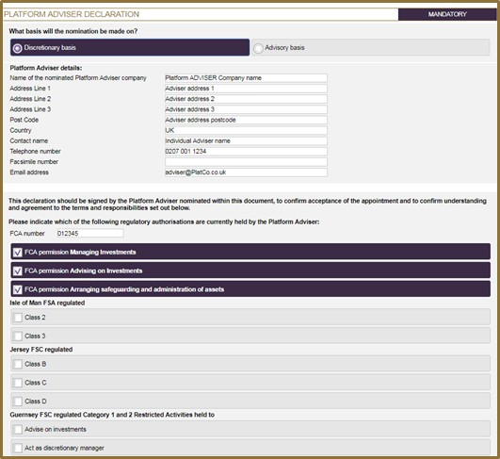
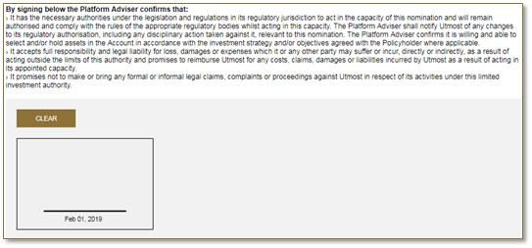
KEYING AN ONLINE APPLICATION
PLATFORM/PLATFORM ADVISER
If a Platform/Platform Adviser is nominated, an authorised signatory must read and sign the Platform Declaration on behalf of the Platform Adviser.
If using a touchscreen device with a stylus, the authorised signatory can sign electronically.
Alternatively, we will accept a PDF version of the form to be printed, signed and scanned on to the portal via the notes tab.
16
UL PR 0270 | 11/22

Slide 17


KEYING AN ONLINE APPLICATION
FINANCIAL ADVISER & FINANCIAL ADVISER CHARGES
The financial adviser details are required in all instances and must be completed in full.
Once complete, the financial adviser must sign this section either with a stylus, or on a printed copy, to then be uploaded online.
Utmost International Isle of Man Limited can faciltate an initial adviser charge taken either inside or outside of the bond, as well as ongoing adviser charges. The tax implications of these charges must be considered before completing this section.
For further information, refer to our Literature Library on www.utmostinternational.com. Here you will find various useful documents such as our Guide to Charges.
17
UL PR 0270 | 11/22

Slide 18
KEYING AN ONLINE APPLICATION
INVESTMENT ADVISER & INVESTMENT ADVISER CHARGES
If the Platform Adviser details have already been completed, these will prepopulate the details for the Investment Adviser (IA). Where there is no nominated Platform Adviser, you may wish to appoint an IA in this section.
The IA must read and sign the declaration within this section to confirm the nature of the advice.
Once an IA has been nominated, ongoing investment adviser charges may be faciltated through the bond.
The charge must be agreed by all applicants, they must read and sign the Investment Adviser charging declaration on the 'submit' tab.
18
UL PR 0270 | 11/22

Slide 19
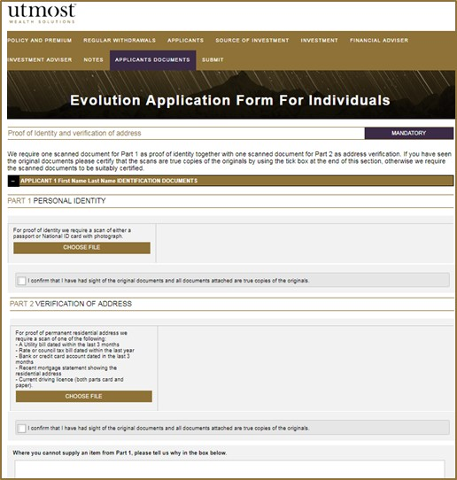
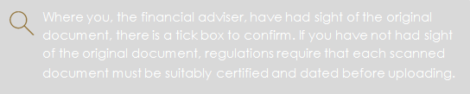

KEYING AN ONLINE APPLICATION
APPLICANT DOCUMENTS
We are required to obtain proof of identity and proof of address for each individual in all instances. Using the 'applicant documents' tab, you can upload scanned copies of ID and address verification.
Where you, the financial adviser, have had sight of the original document, there is a tick box to confirm. If you have not had sight of the original document, regulations require that each scanned document must be suitably certified and dated before uploading.
In exception circumstances, where an applicant cannot supply an item from Part 1, we require a reason why and an additional form of address verification, as indicated in Part 2.
19
UL PR 0270 | 11/22

Slide 20
KEYING AN ONLINE APPLICATION
NOTES
Within the online application, there is a 'notes' tab which allows you to provide any additional commentary which may be useful.
You may also wish to upload additional documentation i.e. evidence of source of investment etc.
This is also where you would scan your signed application form should a stylus not be available.
There is no limit to the information or documents provided within this section, it is purely at your discretion and what additional information you feel is of relevance to the application.
20
UL PR 0270 | 11/22

Slide 21


SIGN AND SUBMIT
FINAL SUBMISSION AND DECLARATIONS
Once the data entry is complete and you are ready to submit the completed application to Utmost, click the 'submit' tab. This tab holds all of the required declarations which must be carefully read by the applicant(s) and signed accordingly.
Questions which have not been filled out will not form part of the final application submission, so it is essential that you are happy with the completed data before submitting the application. You are not able to make any changes once the online application has been submitted.
21
UL PR 0270 | 11/22

Slide 22
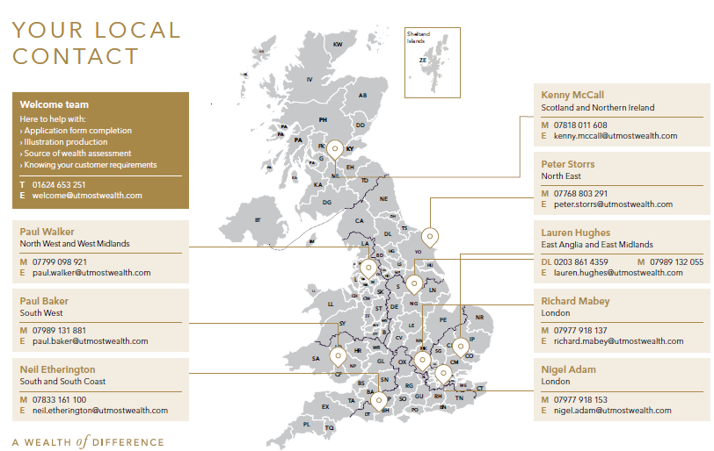
YOUR LOCAL CONTACT
Kenny McCall
Scotland and Northern Ireland
22
UL PR 0270 | 11/22

Slide 23




CONTACT US
+44 (0) 1624 6653 251
welcome@utmostwealth.com
Utmost International Isle of Man Limited King Edward Bay House King Edward Road Onchan Isle of Man IM99 1NU British Isles
www.utmostinternational.com
23
UL PR 0270 | 11/22

Slide 24

IMPORTANT INFORMATION
The information contained in the document does not constitute advice. It is designed for financial adviser use only and not intended for use with individual investors.
Information regarding tax and practice is based on our interpretation of current legislation and HM Revenue & Customs policy/practice in the UK, Isle of Man and Ireland as at 1 January 2021. Tax treatment is subject to change and individual circumstances. There is therefore a risk that the value of the tax treatment provided by a bond may change.
International bonds are intended to be a medium (at least 5 years old) to long term (over 10 years) investment. The value of investment may fall as well as rise and is not guaranteed. Your client or their trustees may get back less than they originally invested.
www.utmostinternational.com
Calls may be monitored and recorded for training purposes and to avoid misunderstandings.
Utmost International Isle of Man Limited is registered in the Isle of Man under number 24916C. Registered Office: King Edward Bay House, King Edward Road, Onchan, Isle of Man, IM99 1NU, British Isles. Tel: +44 (0)1624 643 345. Licensed by the Isle of Man Financial Services Authority.
Utmost Wealth Solutions is registered in the Isle of Man as a business name of Utmost International Isle of Man Limited.
24
UL PR 0270 | 11/22

